Slide 1
Formal Grammar
Lecture 6
Rowaida AL-Amri

Slide 2
Syllabus

Slide 3
Introduction
In computing theory, we need a precise and mathematical way to describe the languages that machines can handle. Therefore, we use the concept of formal grammars.

Slide 4
Why is grammar important in computing theory?
1- Because it allows us to study language mathematically. Satch as , Instead of saying:
The language contains an equal number of a’s and b’s. we can construct a precise grammar such as: S→aSb∣ϵ
Through this, we can:
- Identify valid words in the language.
- Study the process of derivation.
- Construct parse trees.
- Study ambiguity.
- Relate the language to automata.
- Determine the language’s type in the Chomsky hierarchy.

Slide 5

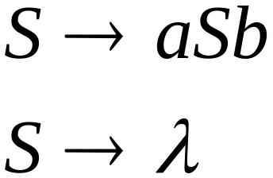



Definition of Grammar
Grammar : It is a description of the process of transition from one form to another and can be used any number of times.
A grammar is a set of rules that defines how valid words and sentences can be generated in a particular language.
Grammar = a set of rules for generating language.
Example:
Grammar:
Derivation of sentence :

Slide 6
Definition of Grammar
The formal grammar is usually defined by the quadruple:
  G=(V,T,P,S) where:
V: the set of variables or non-terminal symbols.
T: the set of terminal symbols(same as an alphabet, Σ)
P: the set of production rules.
S: the start symbol.
Example:
  S → aS | A
  A→ bA | λ
V=Non-terminals
T=Terminals
P=Production Rules
S=Start Symbol

Slide 7
Definition of Grammar
The difference between Terminal and Non-terminal
Terminal symbol: A symbol from the alphabet. In other words, it is the original symbol in the word, and we never attempt to replace it (it is also called a terminal symbol). For example: a, b, 0, 1
Non-terminal symbol: This is a symbol used within a word that is not one of its terminal symbols. In other words, it is a symbol that must be replaced during transformation (transition) operations (and is sometimes called a non-terminal symbol).
We usually denote it with capital letters: S, A, B For example:
V = {S, A}

Slide 8
Production Rules
Production rules specify how to replace a non-terminal with other symbols.
For example :
S→aS and S→b
This means we can replace S either with aS or with b.

Slide 9
Production Rules
We derive a word from these rules. We start with:
1- S Then: 2- S⇒aS Then: 3- aS⇒aaS Then: 4- aaS⇒aab
So the resulting word is: aab
Thus, this grammar can generate:
b, ab, aab, aaab,…
That is, the language is:
L(G)={a ^{n} b ∣ n≥0 }

Slide 10

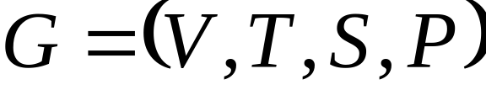
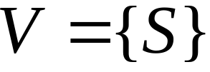
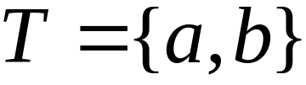
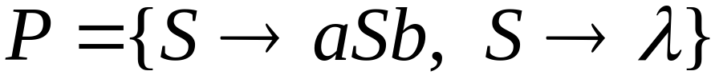
Example
Grammar :

Slide 11
Derivation
Derivation is the process of applying Production Rules starting from the Start Symbol until we reach a string that contains only Terminals.
- We use Derivation to go from S to the final word.
For example, we have: S→aS S→b To produce: aaab
We start: S Then: S⇒aS Next: aS⇒aaS Then: aaS⇒aaaS Next: aaaS⇒aaab So:
S⇒ aS⇒aaS⇒aaaS⇒aaab
This is called a derivation of the word aaab.

Slide 12
Derivation
Strings are “derived” from a grammar
Example of a derivation
  S ⇒ aS ⇒ aaS ⇒ aaA ⇒ aabA ⇒ aab
At each step, a nonterminal is replaced by the sentential form on the right-hand side of a rule (a sentential form can contain nonterminals and/or terminals)
Automata recognize languages; grammars generate languages

Slide 13
More Notation
Sentential Form (نموذج الجملة):
A sentence that contains
Variables and terminals
تتكون الجملة من الرموز المساعدة والرموز الأصيلة
Example:
Sentential Forms
sentence

Slide 14

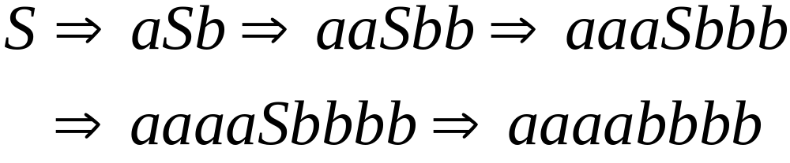
Derivation of sentence :
Other derivations:

Slide 15
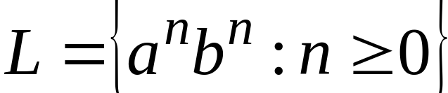
Language of the grammar

Slide 16
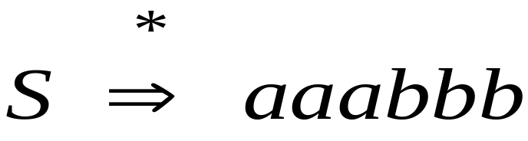
We write:
Instead of:

Slide 17
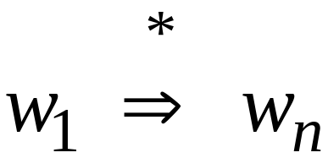
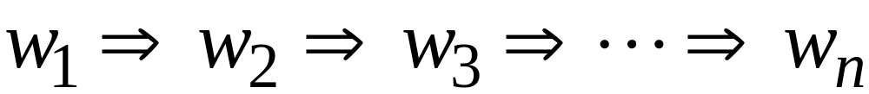
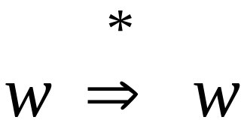
In general we write:
If:
By default:

Slide 18
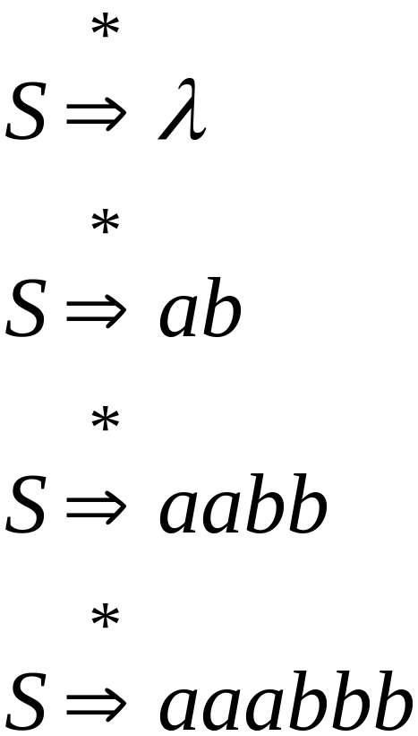
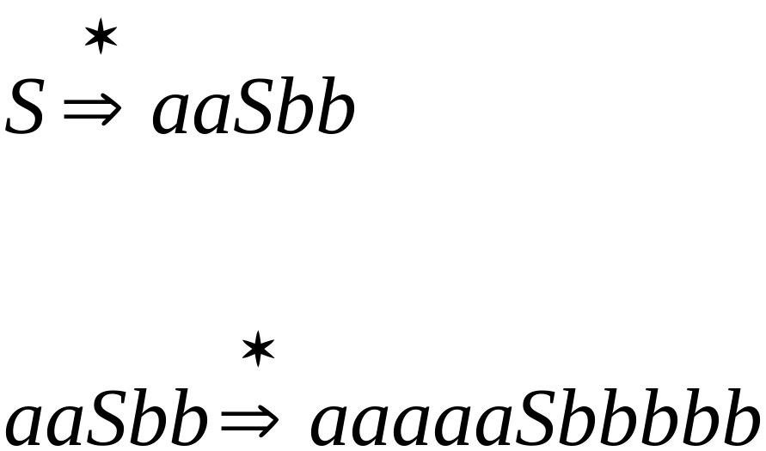
Examples
Grammar:

Slide 19
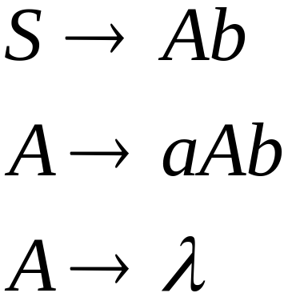
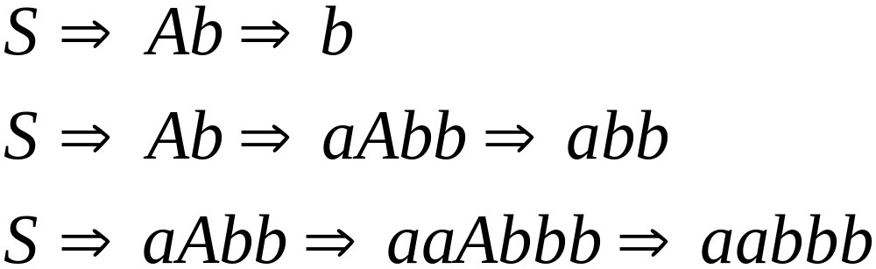
Another Example
Grammar G:
Derivations :

Slide 20
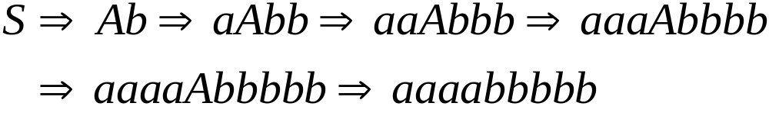
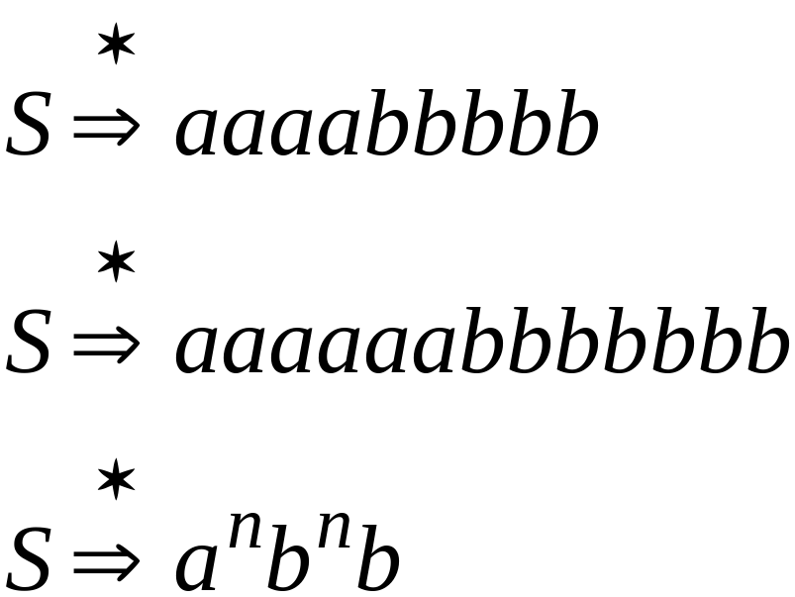

Slide 21
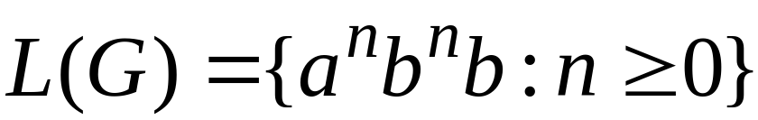
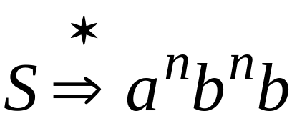
Example
For grammar G:
Since:

Slide 22
Context-free grammar
A grammar is said to be context-free if every rule has a single non-terminal on the left-hand side
This means you can apply the rule in any context. More complicated languages (such as English) have context-dependent rules. A language generated from a context-free grammar is called a context-free language

Slide 23
Language of a Grammar
The language produced by Grammar is denoted by: L(G)
which means:
The set of all strings that can be derived from the start symbol S.
That is: L(G)={ w ∈ T ∗ ∣ S ⇒ ∗ w} where:
w : is a word composed of Terminals.
T∗ :is all possible strings of terminal symbols, including the empty string.
∗ : means the possibility of performing zero or more derivation steps.

Slide 24

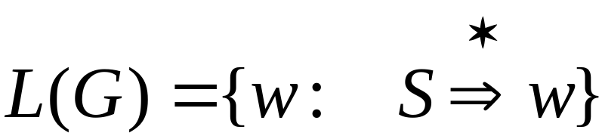
Language of a Grammar
For a grammar
with start variable

Slide 25
Linear grammar
Linear grammar is a type of context-free grammar (CFG),
A grammar can be linear without being right- or left-linear.
A linear grammar: is a grammar in which at most one variable can occur on the right side of any production rule, without any restriction on the position of the variable. (Grammars with at most one variable on the right side of a production )
Example:
  S → aS | A
  A→ Ab | λ

Slide 26

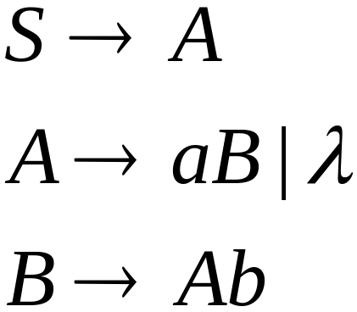
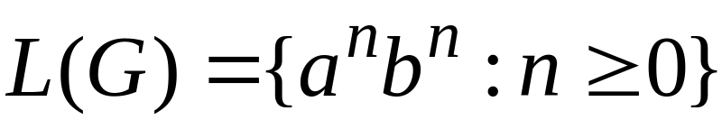
Another Linear Grammar
Grammar

Slide 27


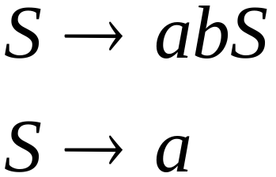
Right-Linear Grammars
A grammar is said to be right-linear if all productions are of the form A→xB or A→x, where A and B are variables and x is a string of terminals
All productions have the form:
Example:
or

Slide 28

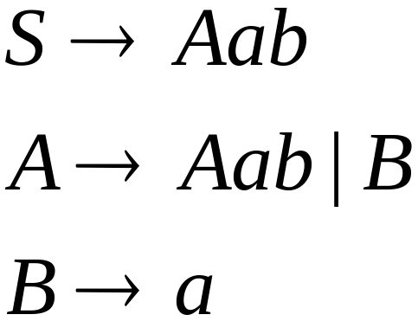
Left-Linear Grammars
A grammar is said to be left-linear if all productions are of the form A→Bx or A→x
All productions have form:
Example:
or

Slide 29
Regular grammar
A grammar is said to be right-linear if all productions are of the form A→xB or A→x, where A and B are variables and x is a string of terminals
A grammar is said to be left-linear if all productions are of the form A→Bx or A→x
A regular grammar is any right-linear or left-linear grammar.
Regular Grammar:are production rules in which the right-hand side of the production takes a very specific form.
There are two basic types:
1- Right-Linear Grammar EX: A→Ab
2- Left-Linear Grammar EX : A→Ba

Slide 30
Regular Grammar
Regular grammar is the simplest type of grammar.
Examples include: A→aB or: A→a For example: S→aS S→b This grammar generates:
{a^{n}b | n ≥ 0}
It is directly related to: Finite automata
That is: Regular Grammar ⟷ Finite Automaton

Slide 31
Another formalism for regular languages
- Every regular grammar generates a regular language, and every regular language can be generated by a regular grammar.
- A regular grammar : is a simpler, special-case of a context-free grammar
- The regular language:s are a proper subset of the context-free languages

Slide 32
Regular Grammars
Examples:

Slide 33
What is the difference between linear grammar and regular grammar?
Every regular grammar is a linear grammar, but not every linear grammar is a regular grammar.
For example: S→aSb
This is a linear grammar because it contains only one variable. However, it is not a regular grammar because the variable S appears in the middle.
S→aS Linear Grammar & Right-Linear Grammar & Regular Grammar
Regular Grammar ⊆ Linear Grammar

Slide 34
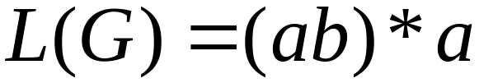
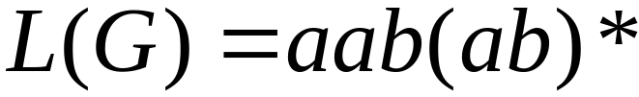
Observation
Regular grammars generate regular languages
Examples:
Grammar G:
Grammar G:

Slide 35
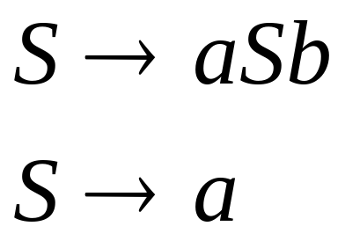
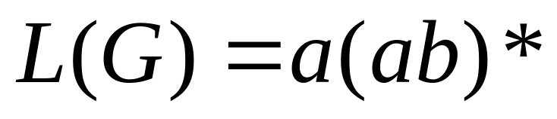
Observation
What is the type of the following Grammar:
It is a Linear Grammar (Since 1 variable to the right of 1st production)
It is not Regular (Since it is not left nor right- Linear Grammar)
Grammar G:

Slide 36

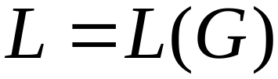
Theorem
A Language is regular
if and only if
there is a grammar such that

Slide 37
Example 1
The following grammar generates the language on Σ = {a,b} consisting of all strings with no more than three a’s
S → bS | aA | λ
A → bA | aB | λ
B → bB | aC | λ
C → bC | λ

Slide 38
Example 2 (1)
Given a grammar, you should be able to say what language it generates
Use set notation to define the language generated by the following grammar
S → aaSB | λ
  B → bB | b

Slide 39
Example 2 (2)
S → aaSB | λ
B → bB | b
It helps to list some of the strings that can be formed:
S ⇒ aaSB ⇒ aaB ⇒ aab
S ⇒ aaSB ⇒ aaB ⇒ aabB ⇒ aabb
S ⇒ aaSB ⇒ aaB ⇒ aabB ⇒ aabbB ⇒ aabbb
S ⇒ aaSB ⇒ aaB ⇒ aabB ⇒ aabbB ⇒ aabbbB ⇒ aabbbb
S ⇒ aaSB ⇒ aaaaSBB ⇒ aaaaBB ⇒ aaaaBb ⇒ aaaabb
S ⇒ aaSB ⇒ aaaaSBB ⇒ aaaaBB ⇒ aaaaBbB ⇒ aaaaBbb ⇒ aaaabbb
What is the pattern?
L = {(aa)^{n}b^{n}b*}

Slide 40
Example 3 (2)
Give a regular (right-linear) grammar for the language consisting of all strings over {a, b, c} that begin with a, contain exactly two b’s, and end with cc
S → aA
A → bB | aA | cA
B → bC | aB | cB
C → aC | cC | cD
D → c

Slide 41
Theorem 1(1)
G NDFA
Every language generated by a right-linear grammar is regular.
Proof:
  Specify a procedure for automatically constructing an NDFA that mimics the derivations of a right-linear grammar.

Slide 42
Theorem 1(2)
G NDFA
Justification:
  The sentential forms produced by a right linear grammar have exactly one variable, which occurs as the rightmost symbol.
  Assume that our grammar has a production rule
  D → dE and that, during the derivation of a string, there is a step wcD ⇒ wcdE
  We can construct an NDFA which has states D and E, and an arc labeled d from D to E.
  NDFAs can be converted to DFAs.
  All languages accepted by DFAs are regular.

Slide 43
Theorem 1(3)
G NDFA
Construction:
  For each variable V_{i} in the grammar there will be a state in the automaton labeled V_{i}.
  The initial state of the automaton will be labeled V₀ and will correspond to the S variable in the grammar.
  For each production rule V_{i} → a₁a₂…a_{m}V_{j} the automaton will have transitions such that δ*(V_{i} → a₁a₂…a_{m}) = V_{j}
  For each production rule V_{i} → a₁a₂…a_{m} the automaton will have transitions such that δ*(V_{i} → a₁a₂…a_{m}) = V_{final}

Slide 44
Theorem 1(4)
G NDFA
Construct an NDFA that accepts the language generated by the grammar:
S → aA convert to: V₀ → aV₁
A →abS | b V₁ → abV₀ | b
a
b
V₀
V₁
V_{f}
b
a

Slide 45
Theorem 2(1)
DFA G
Every regular language can be generated by a right-linear grammar.
Proof:
  Specify a procedure for automatically constructing a right-linear grammar from the DFA.

Slide 46
Theorem 2(2)
DFA G
Given a regular language L, let M = (Q, Σ, δ, q₀, F) be a DFA that accepts L. Let Q = {q₀, q₁, …, q_{n}} and Σ = {a₁, a₂, …, a_{m}}.
Construct the grammar G = (V, T, S, P) with:
V = {q₀, q₁, …, q_{n}}
T = {a₁, a₂, …, a_{m}}
S = q₀.
P = {} initially.
P, the set of production rules, is constructed as follows:

Slide 47
Theorem 2(3)
DFA G
For each transition
δ(q_{i}, a_{j}) = q_{k}
in the transition table of M, add to P the production:
q_{i} → a_{j}q_{k}
If q_{k} is in F, then add to P the production:
    q_{k} → λ

Slide 48
Theorem 2(4)
DFA G
Example: Construct a right-linear grammar for the language L = L(aab*a)
First, build an NDFA for L:
a
a
a
q₀
q₁
q₂
q_{f}
b

Slide 49
Theorem 2(5)
DFA G
a
a
a
q₀
q₁
q₂
q_{f}
b
P = {} initially.
Add to P a rule for each transition in the NDFA:
q₀ → aq₁
q₁ → aq₂
q₂ → bq₂
q₂ → aq_{f}
Since q_{f} is in F, add to P the production:
q_{f} → λ

Slide 50
Theorem 2(6)
DFA G
a
a
a
q₀
q₁
q₂
q_{f}
b
Now P = You can convert to normal grammar notation:
{q₀ → aq₁ S → aA
q₁ → aq₂ A → aB
q₂ → bq₂ B → bB
q₂ → aq_{f} B → aC
q_{f} → λ } C → λ

Slide 51

Three ways of specifying regular languages
Regular expressions
DFA NDFA
Regular grammars
describe
accept
Regular languages
generate

Slide 52
Regular Grammars
Generate
Regular Languages

Slide 53
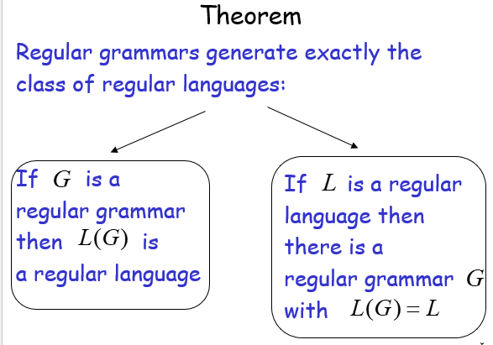

Slide 54
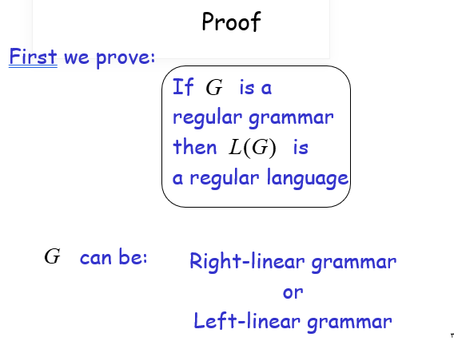

Slide 55
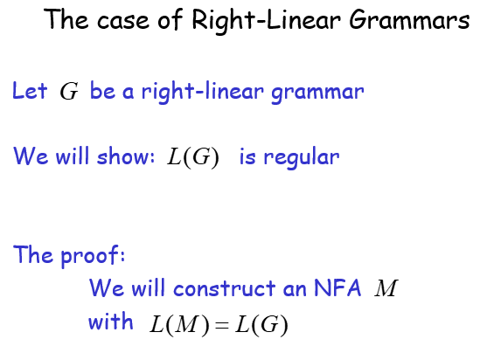
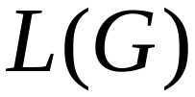

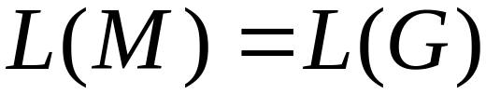

Slide 56
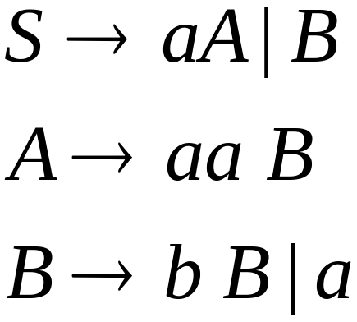
Grammar is right-linear
Example:

Slide 57

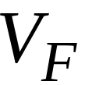

Construct NFA such that
every state is a variable:
special
final state

Slide 58


Add edges for each production:

Slide 59

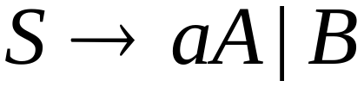

Slide 60
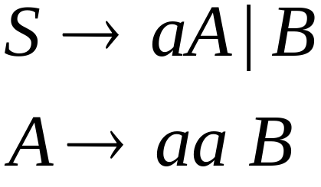

Slide 61
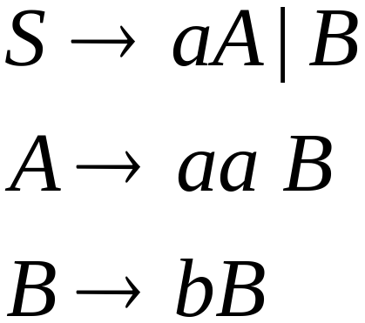


Slide 62
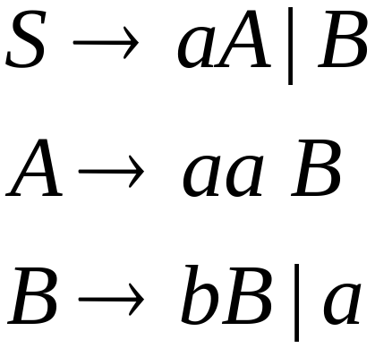

Slide 64
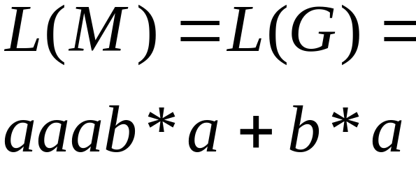
NFA
Grammar

Slide 65
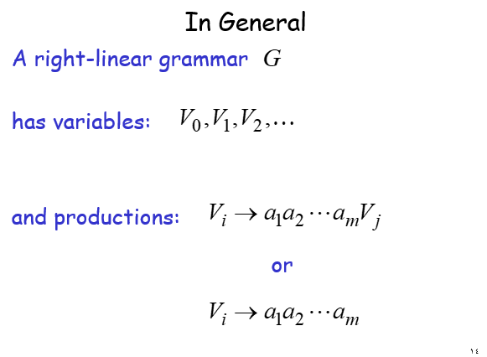
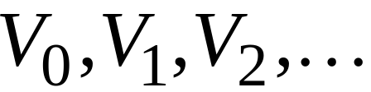
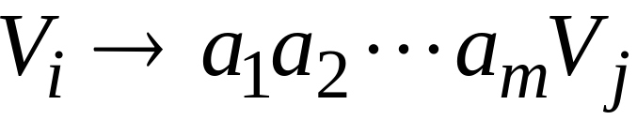
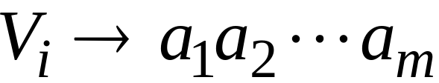
In General
A right-linear grammar
has variables:
and productions:
or

Slide 66
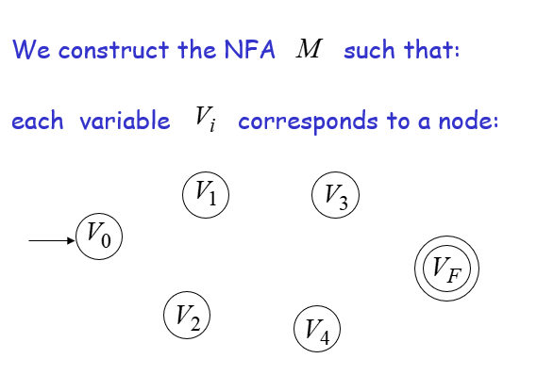






We construct the NFA such that:
each variable corresponds to a node:

Slide 67
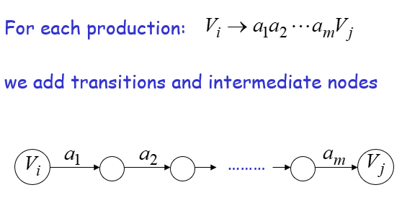

Slide 68
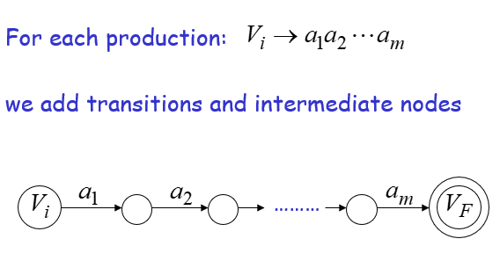

Slide 69
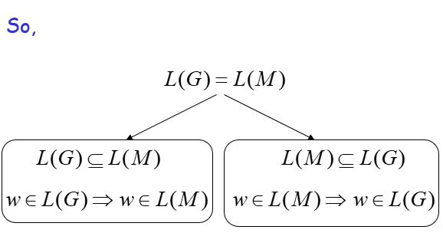

Slide 70
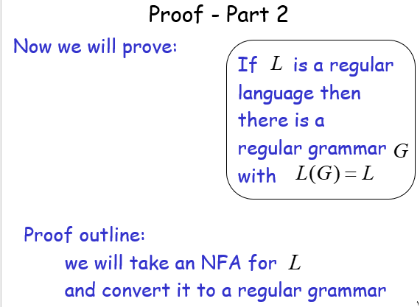

Slide 71


Slide 72


Slide 73


Slide 74


Slide 75


Slide 76


Slide 77

تمرين

Slide 78
Reducibility Automaton
Equivalence Automatons
Chomsky Hierarchy
Sequential Machines
Mealy and Moor Sequential Machines
Sequential function
Analysis Machines
Context-Free Grammar (CFG)

